Slide 1
Cybersecurity for Future Presidents
Lecture 10:
DEBATE #1:
Resolved: The U.S. government should mandate that communication and storage technology providers include a mechanism by which protected data can be obtained under lawful court order.

Slide 2
Any Questions?
My office hours:
Wed. afternoon, 12-3pm, 442 RH
About previous lecture?
About homework?
About reading?
Homework for next week: Reading, Exercises
Reading for next week (for all):
Exercises: Cryptography and applications

Slide 3
Cybersecurity events from the past week of interest to future (or current) Presidents:
Hospital taken offline for a week by ransomware; $3.6M ransom (9,000BTC)
http://www.csoonline.com/article/3033160/security/ransomware-takes-hollywood-hospital-offline-36m-demanded-by-attackers.html
IRS reports 100,000 eFile credentials compromised, PIN guessing
identity thieves used 464,000 SSNs in unauthorized attempts to access an e-file PIN and were successful in obtaining a PIN in 101,000 of those attempts
https://www.irs.gov/uac/Newsroom/IRS-Statement-on-Efiling-PIN
DoJ, HSD employee information published, probably social engineering
Coming up: … ?

Slide 4
Today’s Debate Topic
Debate 1
Resolved: The U.S. government should mandate that communication and storage technology providers include a mechanism by which protected data can be obtained under lawful court order.

Slide 5
Post Debate Discussion
Questions
Consider each of the following – how were they treated in the debate in relation to the topic?
Economy: what effects of mandating legal access paths?
Innovation: what effects on bringing new products to market?
Civil liberties, including freedom of expression, privacy: what effects on openness? How intrusive?
International relations / National Security / Law Enforcement: what effects on preventing/detecting/prosecuting/deterring crime? What effects on international relationships (for dealing with crime but also dealing with governments?)
Existing US Laws and Policies relevant to the discussion
CALEA
ECPA?

Slide 6
Some arguments - pro
Primary argument:
Public safety / national security
Controlled access through warrants, etc
Ability to convict criminals
Innovation: requirement stimulates innovation, creative use of cryptographic mechanisms a possibility
Economics: all countries will want openly designed and implemented legal access
Civil liberties: only used when warranted. No mass surveillance implied, just targeted. Convicting criminals preserves civil liberties for the innocent.

Slide 7
Some arguments - con
National security / law enforcement: yes we can have stronger law enforcement by allowing arbitrary search and seizure but that’s not what the society is about.
Innovation: building in backdoors or frontdoors adds complexity, dampens innovation
Economics: market for devices with “frontdoors” will be limited – will other countries buy products they know have been engineered for US legal access?
Civil rights: existence of these access methods will reduce trust in security of communications and storage, may have chilling effects on communications (eg whistle blowers, background sources for press)

Slide 8
Access to encrypted stored data
5th amendment bars self-incrimination
Courts have prevented forced disclosure if investigators can’t specify what they are looking for
Border crossings

Slide 9
Cryptography basics, continued

Slide 10
Key Cryptographic Concepts for Future Presidents
True random numbers vs. pseudo-random numbers
Perfect Secrecy, and why it’s rarely used
Symmetric cryptography
Asymmetric (public key) cryptography
“trapdoor” or “one-way” functions
Digital signatures
Significance of length of key
Man-in-the-middle attacks

Slide 11
Random vs. Pseudo-random numbers
(True) Random numbers – generated by physical phenomena, unpredictable, not repeatable (except if you record and replay)
Flip a coin, toss a die
Atmospheric noise: see www.random.org
Radioactive decay
Radio noise
Intel on-chip random number generator:
thermal noise triggers metastable circuit, output filtered/tested
Avoid / detect bias: run statistical tests on output
Looking for a uniform distribution (all outcomes equally likely)
Transformations can convert uniform to other distributions
Pseudo random numbers
A string of random numbers that passes statistical tests for randomness, but is generated deterministically
Computer program with “seed” or “initialization vector” to provide a starting value; eventually, the stream will cycle

Slide 12
How to achieve “perfect” secrecy
Perfect secrecy = no matter how much plaintext/ciphertext eavesdropper may have, still can’t decipher a new message
Believe it or not, this is achievable: (“one-time pad”)
Requires
Key bits must be truly random (i.e., generated by a natural random process, not a computer program)
Key must never be re-used* to encrypt another message
1 bit of key for each bit of message
Recipient must have the same key (and must be able to synchronize the key streams)
Because the key is random, all decryptions are equally likely – so passive eavesdropper can’t determine if proposed decipherment is correct or not.
Also note that an active eavesdropper (one who can manipulate the encrypted bits) can alter the message received (you get secrecy but not integrity)
See Anderson, Sec. 5.2.2 (p. 132) for more detail
*Search for ‘Venona’ for an interesting story of how the Russians misused a one-time pad

Slide 13
Secret Key (Symmetric) Cryptography
In symmetric cryptography, the same key is used for encryption and decryption – as in the ‘XOR’ examples we have done.
In effect, the key is a random number that provides the seed for a cryptographically secure pseudo-random number generator (CSPRNG); the output of that generator is XOR’ed with the data stream as shown above to generate ciphertext
The recipient of the message uses the same key to seed the same algorithm, XOR’s with the received ciphertext and retrieves the plaintext
“Key” question: how to get the key to the recipient?
Pre-distribute
Distribute out-of-band (might be paper, CD, memory stick)
Passive eavesdropper needs to know the algorithm and determine the key to read the message
Assuming the cryptoalgorithm is strong, then the eavesdropper needs to test alternative keys by “brute force” – try them out
Key length then determines the strength of the encryption

Slide 14
Some problems are hard to compute, but easy to check
Can you think of some?
Finding the square (or cube, or ….) root of a number
Sudoku
Finding the prime factors of a large number
Traveling salesman problem
It turns out that you can use some of these “one-way” or “trapdoor” functions to provide asymmetric or “public key” encryption

Slide 15
Public Key (Asymmetric) Cryptography
The sender and the recipient use different keys – one to encrypt and a different one to decrypt (hence asymmetric)
These schemes rely on the fact that there are “trap-door one-way” functions: functions that are easy to compute in one direction but hard to reverse, unless you know the trap-door
The most widely used scheme is based on the difficulty of factoring large composite numbers:
For two large primes, P and Q, computing N = P*Q is easy
But given only N, finding P and Q is hard !
Rivest-Shamir-Adlemen (RSA) public key encryption uses this fact
Keys are generated in pairs, [public key, and secret (private) key]
Plaintext enciphered with one key (public or private) can only be deciphered using the other one
Each party can make one key public, so that two people who have never communicated privately can, given each others public keys, create a message that can’t be read by anyone who doesn’t know the private (secret) key
However, (relative to symmetric crypto algorithms), encryption/decryption are relatively expensive to compute

Slide 16
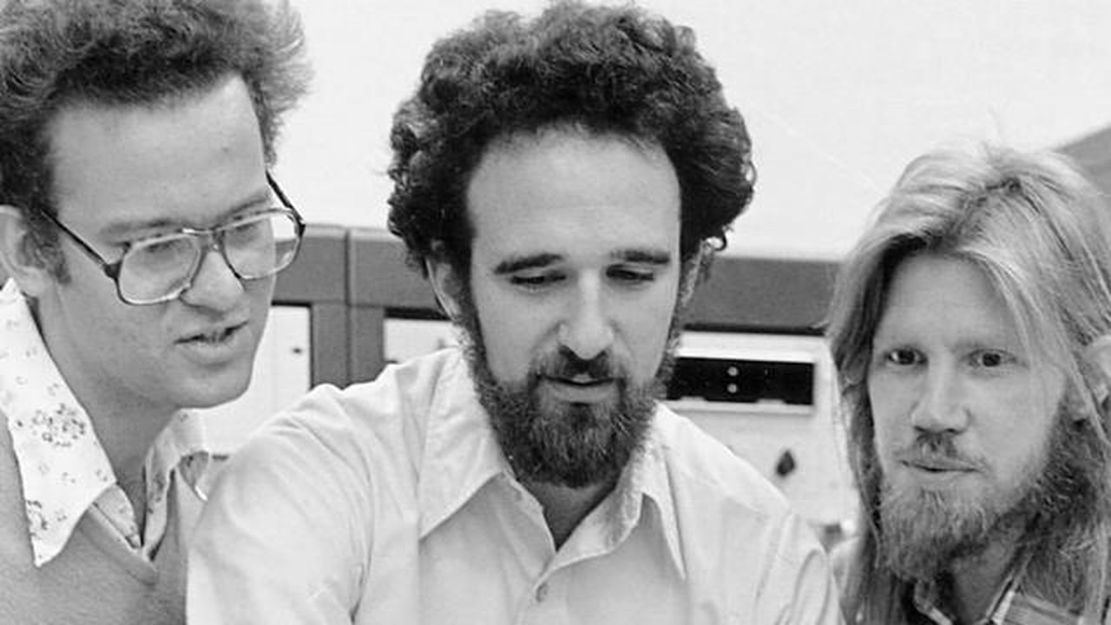
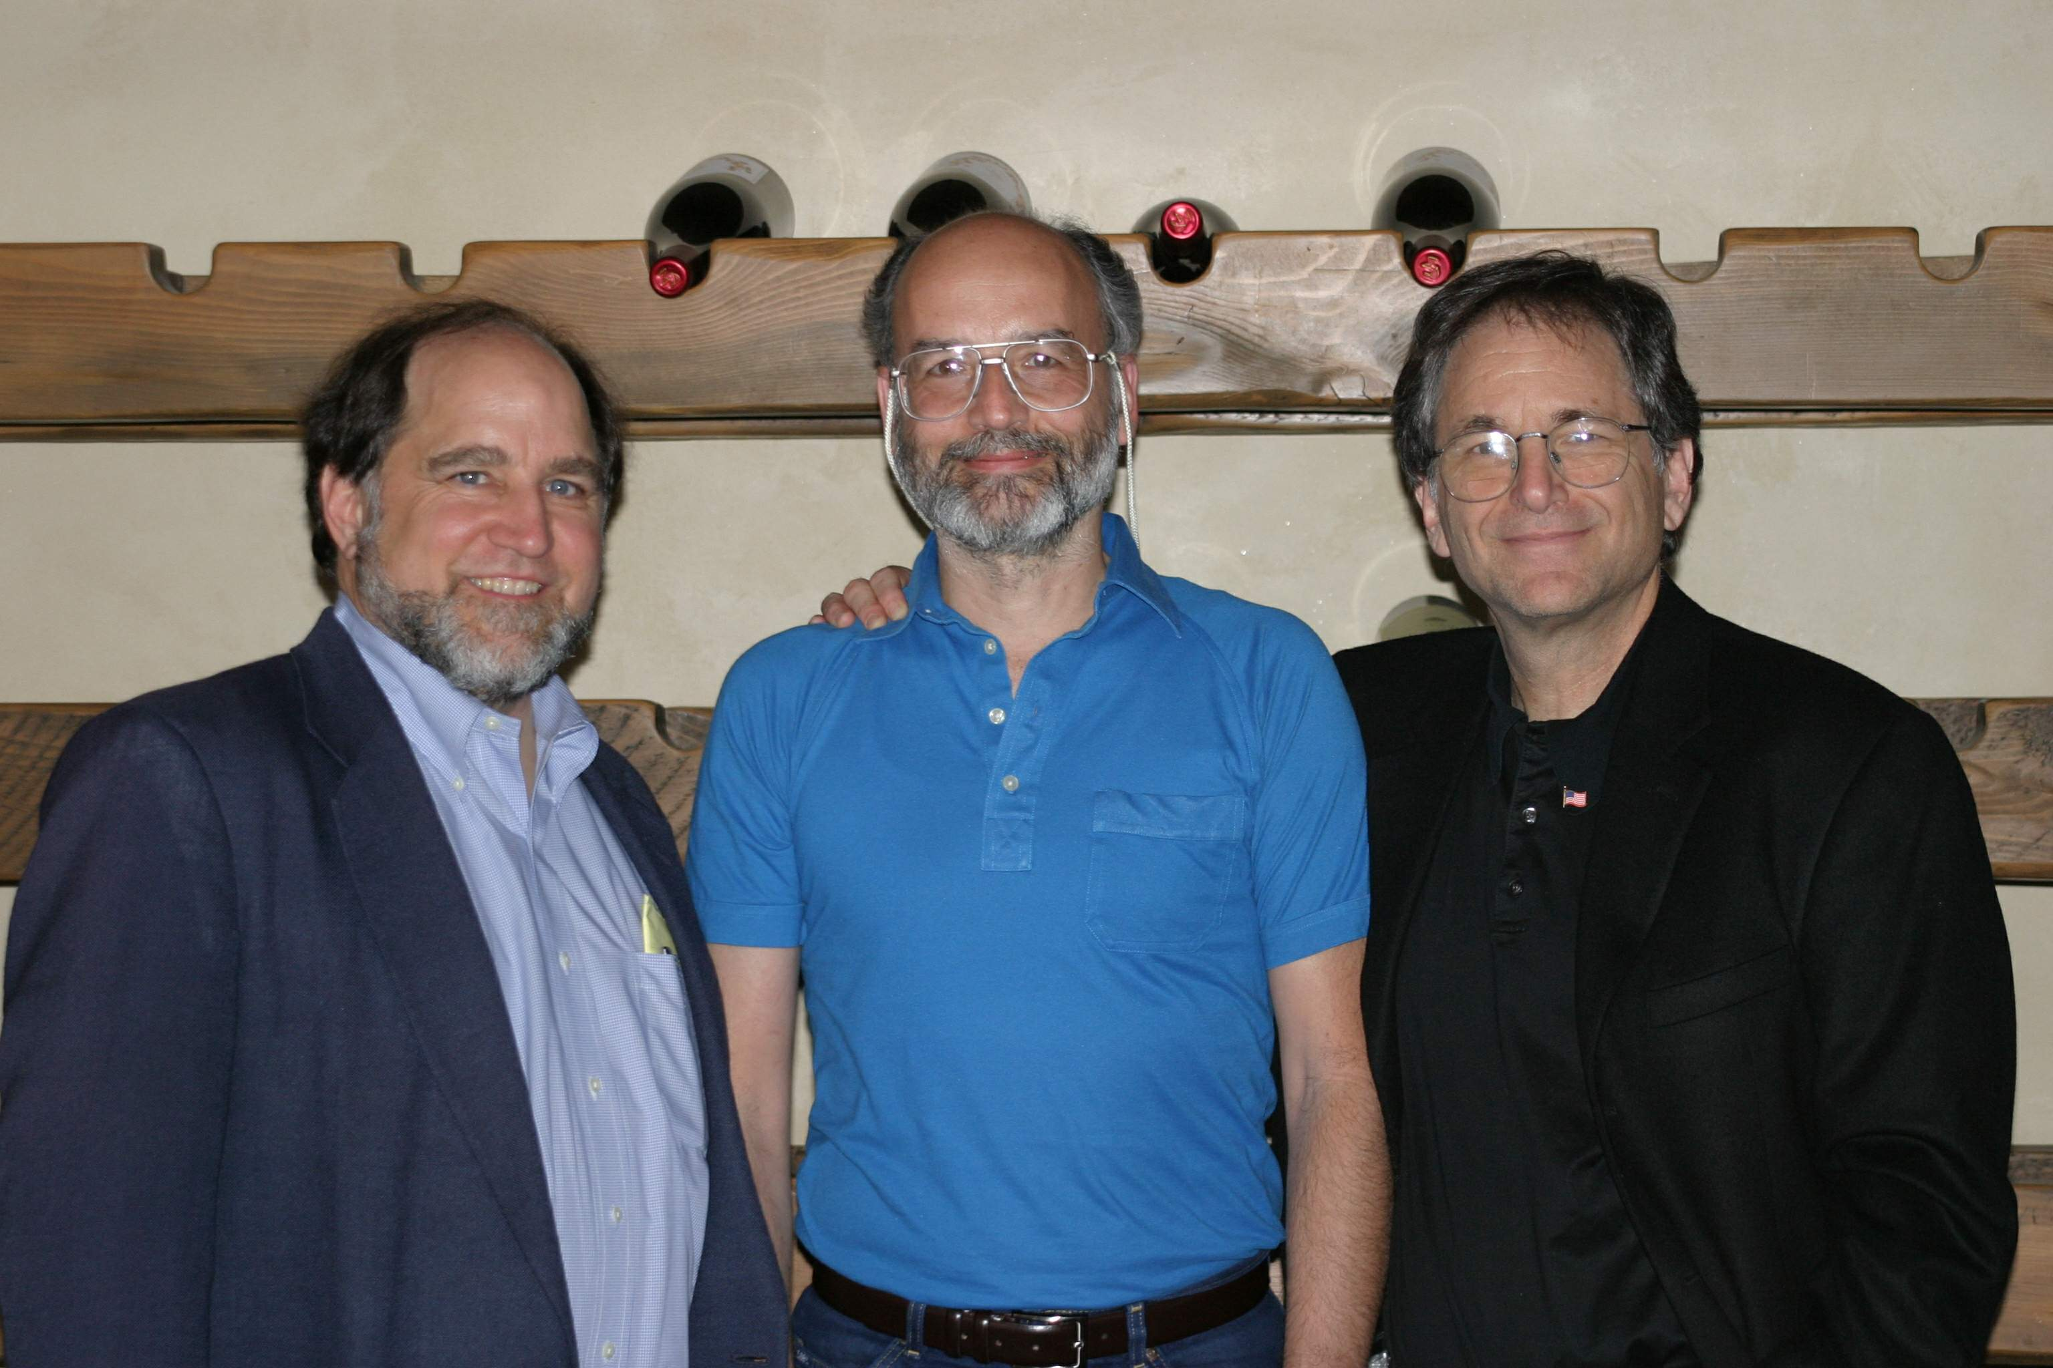
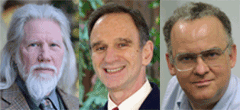
Rivest-Shamir-Adelman
Merkle-Diffie-Hellman
1978?
1976?
2010?

Slide 17
How Public-Key cryptography is used
For exchanging a key for a (much faster) symmetric encryption algorithm that will then be used to encrypt communications over a link. (This is what happens in SSL/TLS to secure web communications)
Alice picks a symmetric key, encrypts it under Bob’s public key and sends to Bob. Bob decrypts it with his private key. They now have a shared symmetric key
Issue: how does Alice get the right public key for Bob?
For signing messages (digital signature):
Alice composes message m, then computes “message digest” – a hash of the message, somewhat like a checksum.
Alice encrypts the hash with her private key and sends message and hash to Bob
Bob receives message with hash; decrypts the hash using Alice’s public key; computes the hash of the message and compares with the decrypted hash from Alice – they should match
Can be used for both authentication and integrity

Slide 18
How public key crypto is used on the web
Public key crypto is a great invention – it seems to solve the key distribution problem. All you need is a phonebook of public keys, right?
Yes, but… whose phonebook do you trust?
Certificate: data structure used to bind an identity to a public key – like the phone book entry
The phonebook publisher is the Certificate Authority (CA); it has its own public key and signs the phonebook entries using its secret key
In theory, to get Bob’s public key, you communicate with the CA (who may ask a higher level CA, etc.) and get back a certificate with Bob’s public key signed by the chain of CA’s who endorse it.
In practice, Bob is likely to be Amazon or Google and Alice is communicating via her browser. The browser comes with a large number of preconfigured Root CA Certificates (I counted over 200 in my store); it will accept connections that are signed by any of those.
The “Superfish” adware publicized in 2015 abused the certificate system.
Certificates normally have expiration dates can be revoked if the holder’s private key is exposed

Slide 19
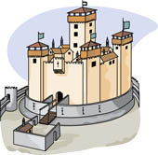
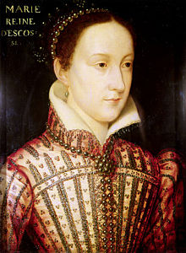
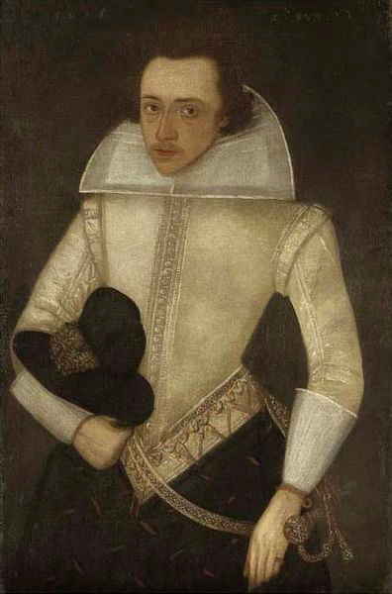
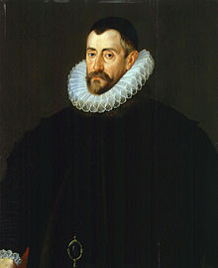
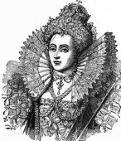
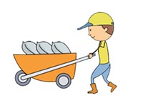
What’s a “Man in the Middle” attack, or How Mary Queen of Scots lost her head in 1587
Mary S.
Anthony B.
*
+
Beer
Francis W.
Elizabeth T.

Slide 20
What’s a good key length (symmetric crypto)?
Decide how long you want the plaintext to be protected
Calculate how long it takes an attacker to test a key
Make sure the size of the key space is much bigger that 2 * (1) / (2)
For an n-bit key, there are 2^{n} possible keys ( 0 -> 2^{n-1} )
Be sure your scheme for generating keys is sufficiently random
Because if the attacker can figure out the key generation scheme, the search space collapses
In 1995, Michael Wiener made a design for a special purpose machine to crack keys for Data Encryption Standard (DES):
56-bit key → on average, crack in 3.5 hours on a $1M machine
64-bit key → 8 more key bits means key space 2⁸=256 times bigger, so 896 hours = 37 days
72-bit key: 26 years, 80-bit: 6,703 years, 88-bit:1.7Million years…
But Moore’s law divides time by 10 every 5 years, roughly:
20 years → divide by 10,000
Today, primary symmetric key algorithm is Advanced Encryption Standard (AES), operated with 128-bit, 192-bit, or 256-bit keys.

Slide 21
Key lengths for public key cryptoalgorithms (RSA)
For RSA, the size of the modulus N (remember N=P*Q where P and Q are large primes) corresponds to the key size of a symmetric cryptosystem
Factoring small numbers is not that hard, so the question is, how large do P and Q need to be?
Initially (mid 1970s) the recommendation was a 200 digit number (or about 664 bits) would suffice. This got rounded down to 512 bits.
The RSA Factoring Challenge provides a list of large numbers to be factored along with substantial prizes for success. The largest number factored to date has 232 decimal digits (768 bits); its factorization was completed in 2009http://en.wikipedia.org/wiki/RSA_Factoring_Challenge
Today, 1024 bits, or more safely, 2048 bits (~617 decimal digits) are seen as appropriately strong to be unassailable at least until quantum computers show up

Slide 22
Rubric for Debaters

Slide 23
Rubric for debate questions

Slide 24
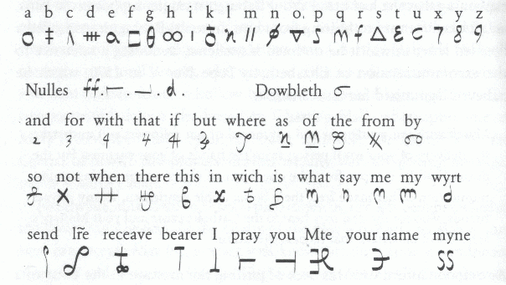
Cipher used by Mary Queen of Scots and Anthony Babington

